Slide 1

PeachTree

Slide 2
About us
Notes:
Introduce ourselves
Talk about previous websites created, what they achieved and any issues we had
Talk about how we incorporate many new agile techniques to improve code and efficiency
Transition – ‘So lets talk about what we’ve been doing recently’

Slide 3
About the project
Notes:
What is the University Magazine Contribution website?
Explain the problem (need students to contribute)
Explain how the system would be implemented (use existing university email addresses and pwds)
What does the system do?
Go through use case for each type of user
Transition – ‘Lets look at some examples of the system in action’

Slide 4
Guest experience
Notes:
This experience is for people who may not belong to any faculty in the university, but are interested in viewing past publications of the magazine.

Slide 5
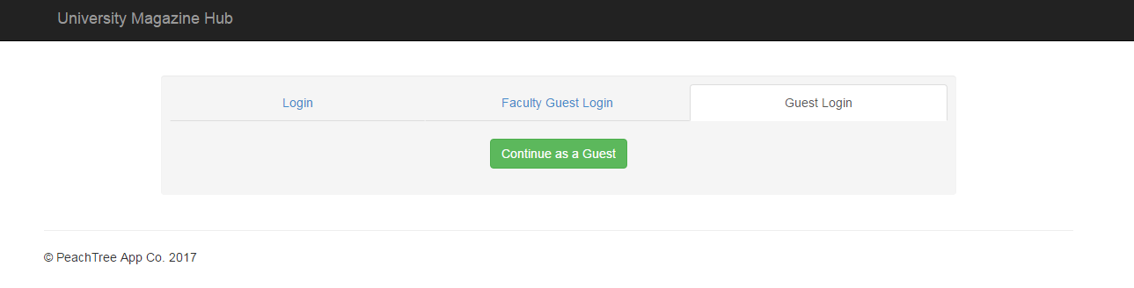
Login

Slide 6
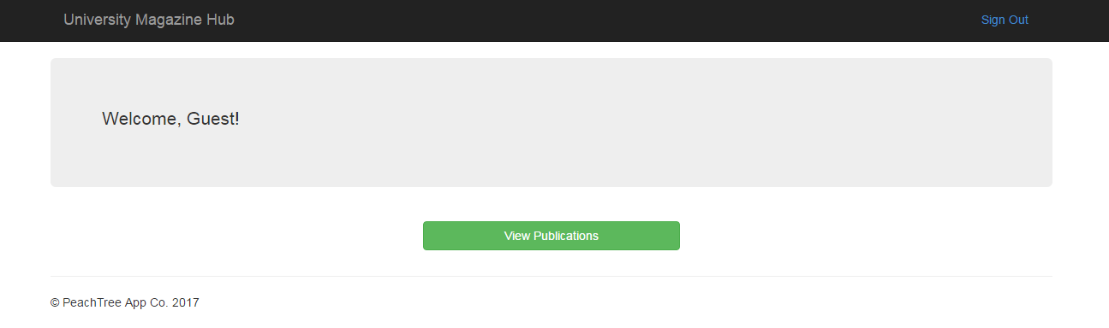
Home

Slide 7
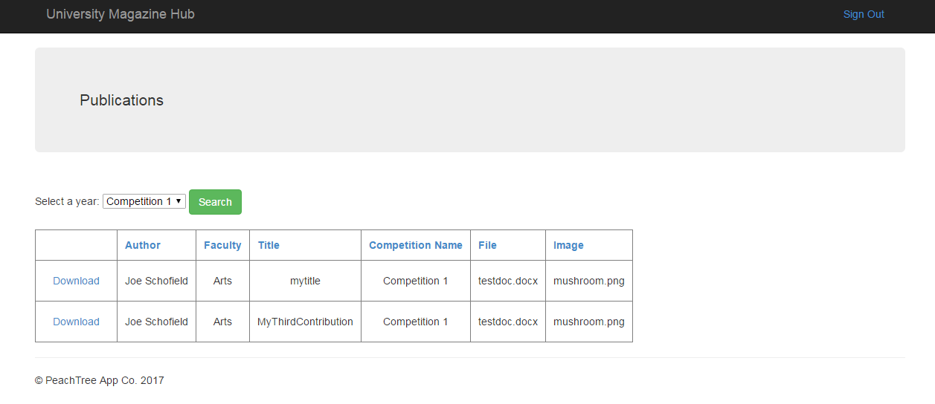
Publications

Slide 8
Faculty guest experience

Slide 9
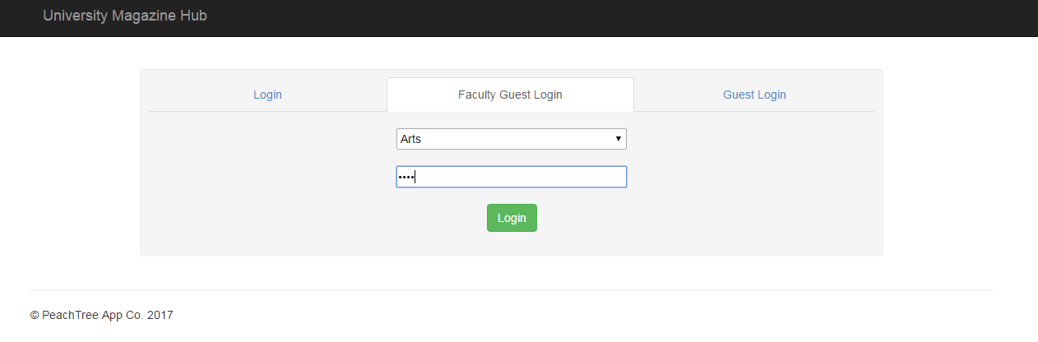
Login

Slide 10
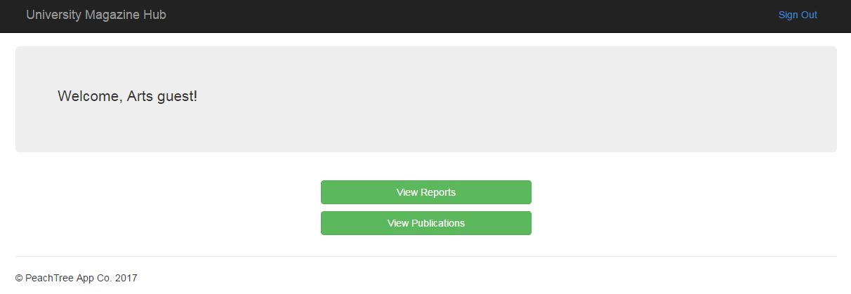
Home

Slide 11
Publications

Slide 12
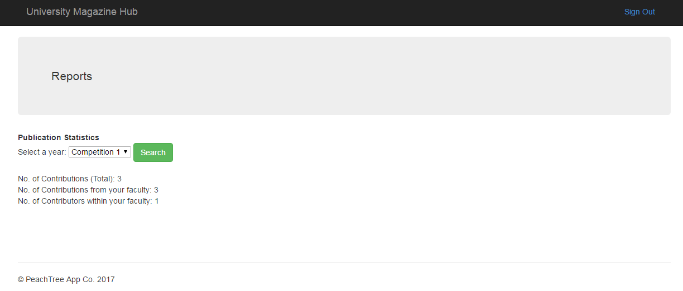
Reports

Slide 13
Student experience

Slide 14
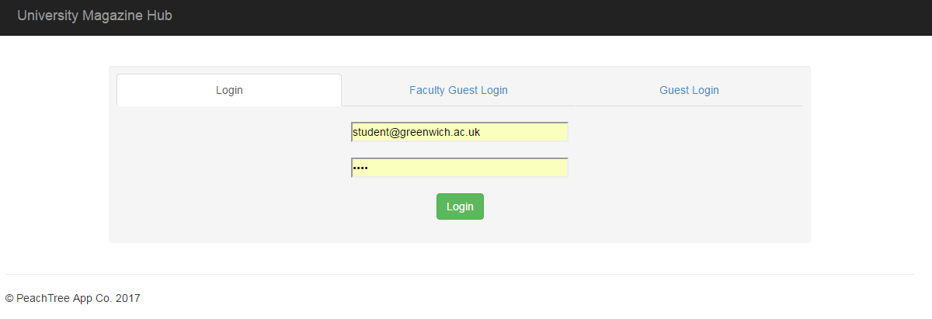
Login

Slide 15
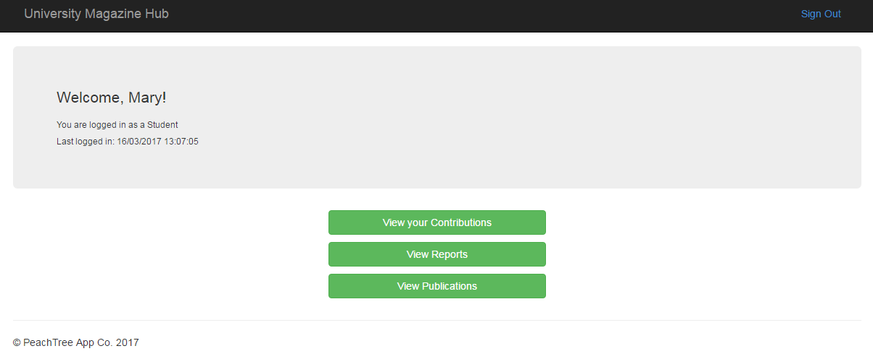
Home

Slide 16
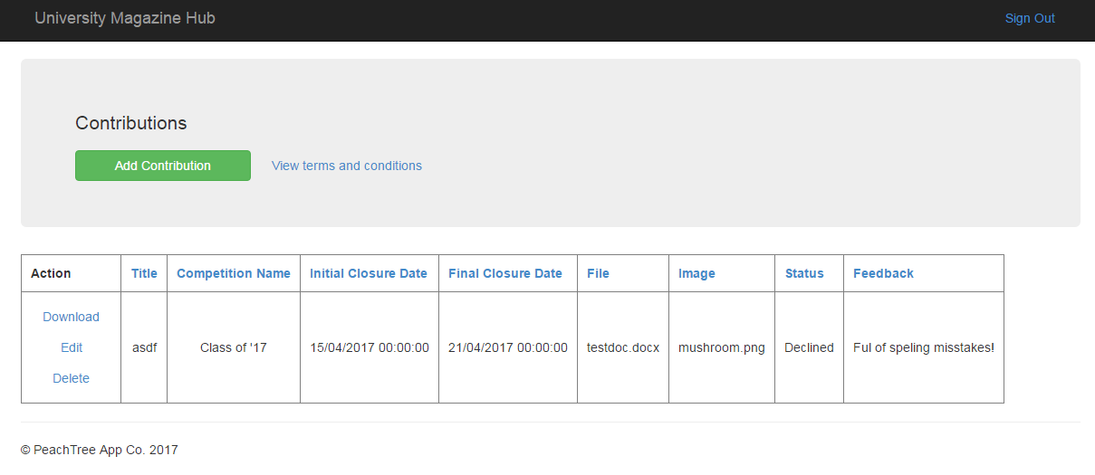
Contributing

Slide 17
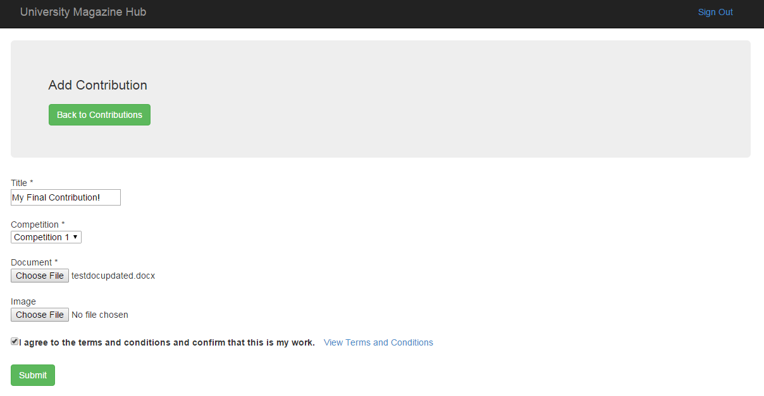
Contributing

Slide 18
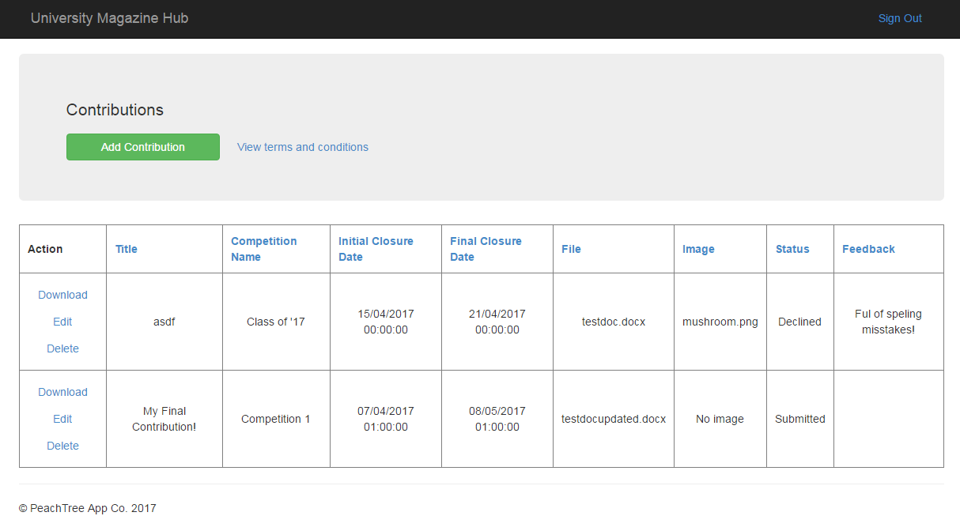
Contributing

Slide 19
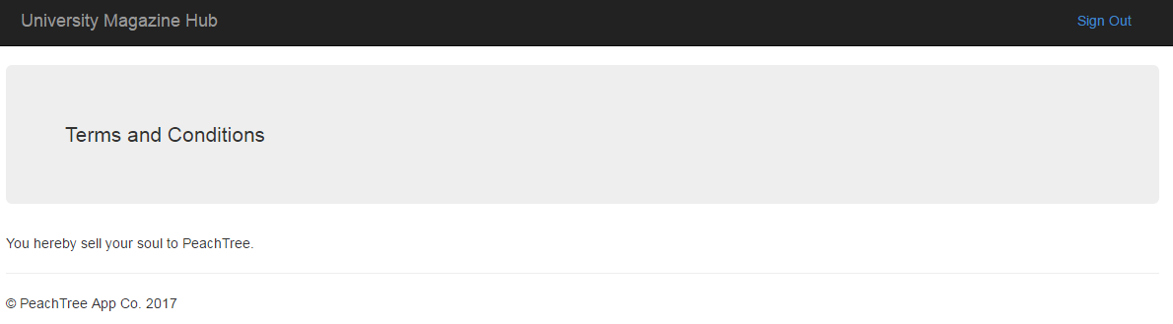
T’s & C’s

Slide 20
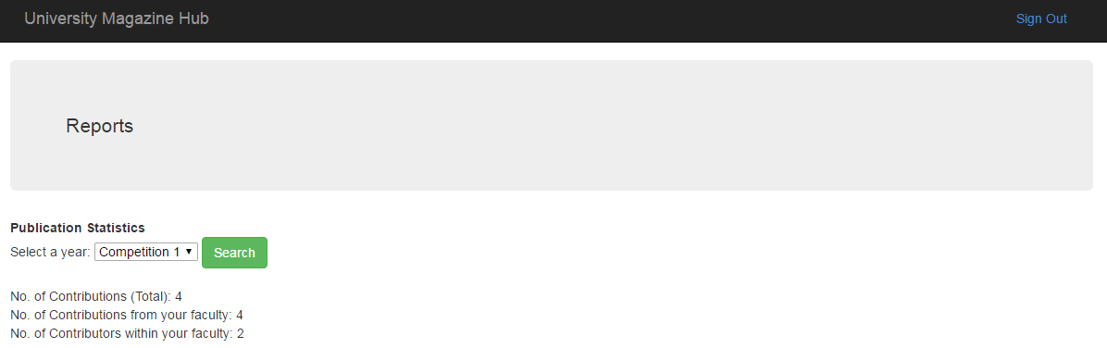
Reports

Slide 21
Publications

Slide 22
Marketing Coordinator
experience

Slide 23
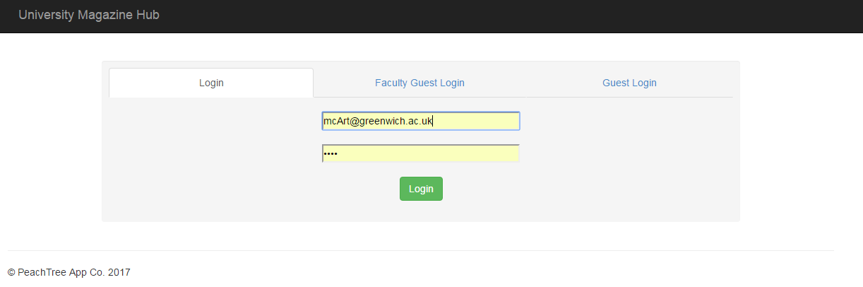
Login

Slide 24
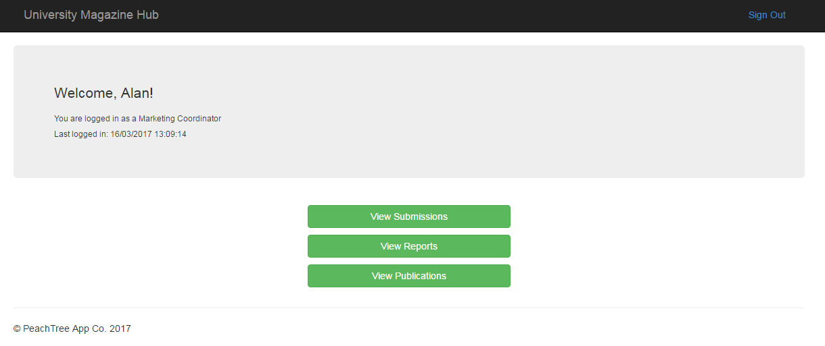
Home

Slide 25
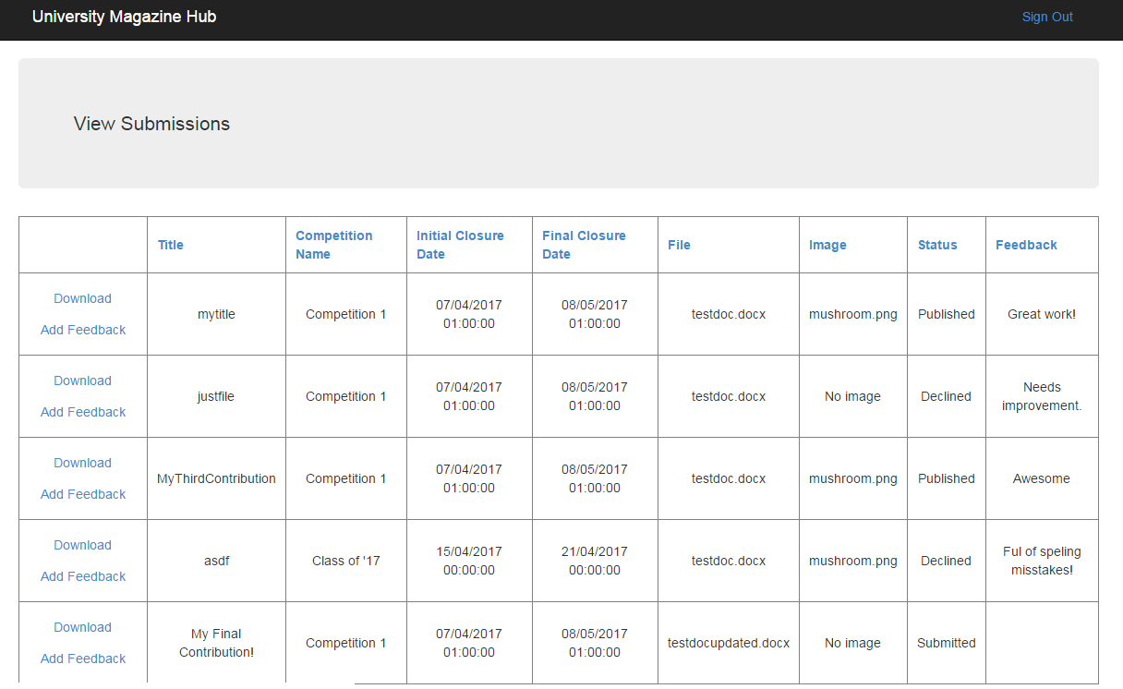
Submissions

Slide 26
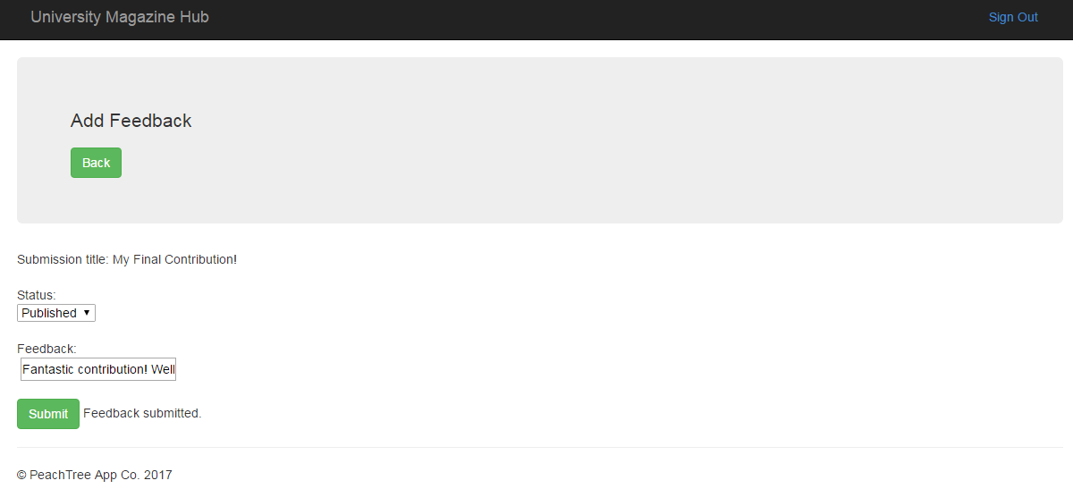
Feedback

Slide 27
Reports

Slide 28
Publications

Slide 29
Marketing Manager
experience

Slide 30
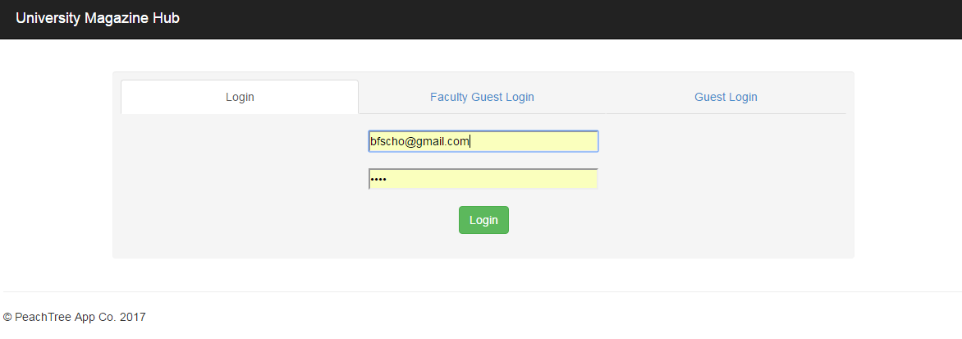
Login

Slide 31
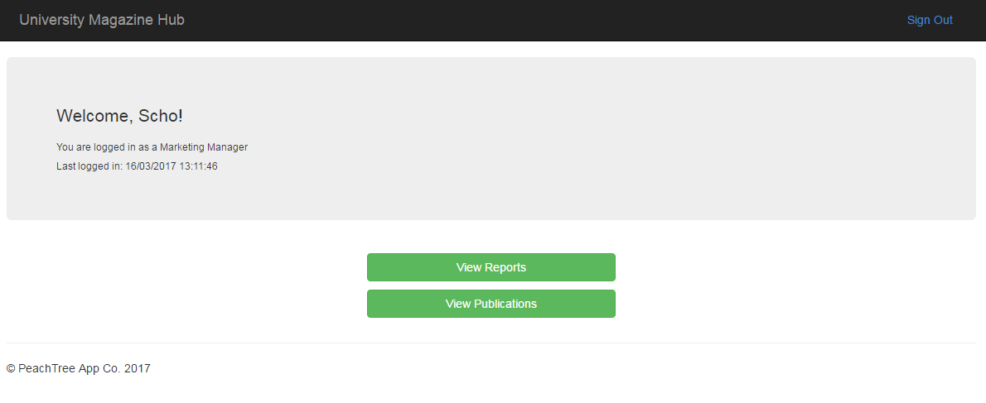
Home

Slide 32
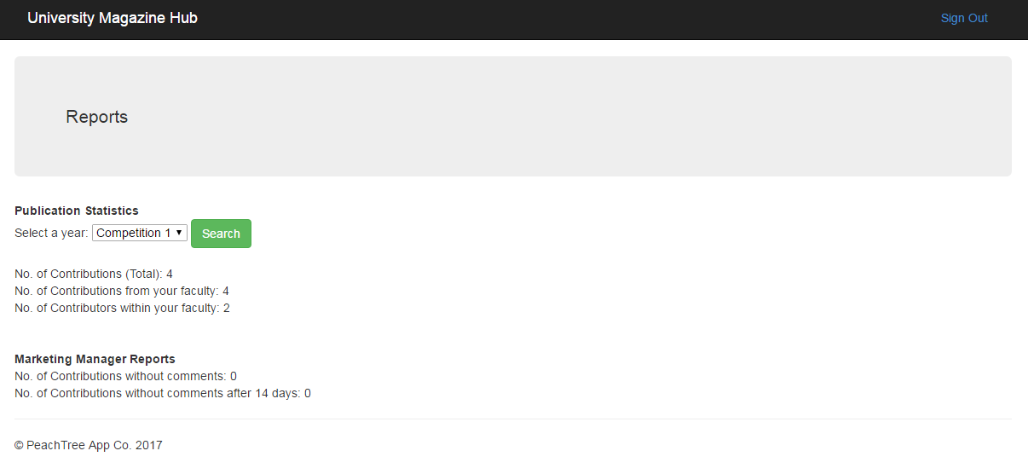
Reports

Slide 33
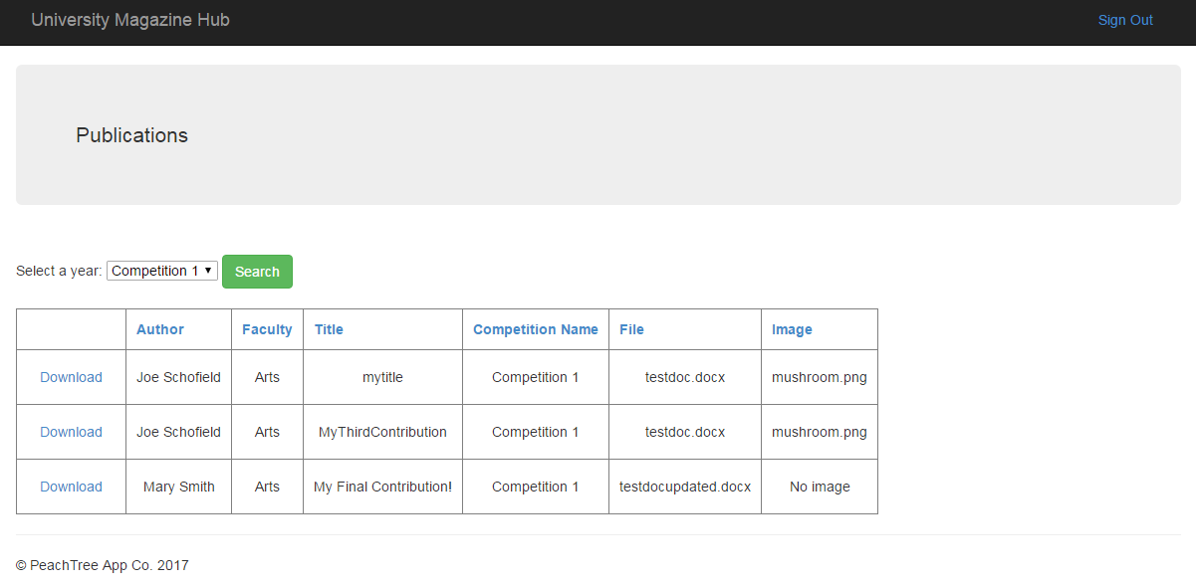
Publications

Slide 34
Administrator experience

Slide 35
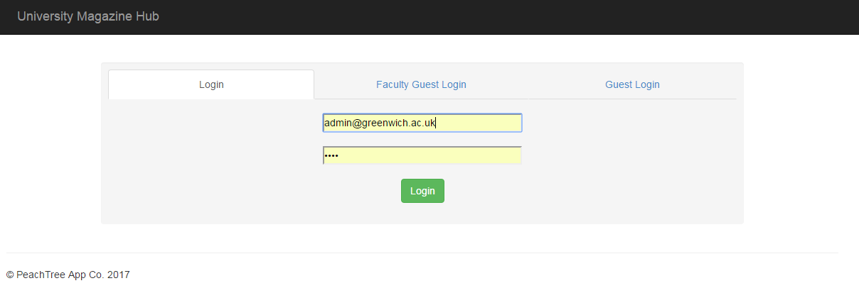
Login

Slide 36
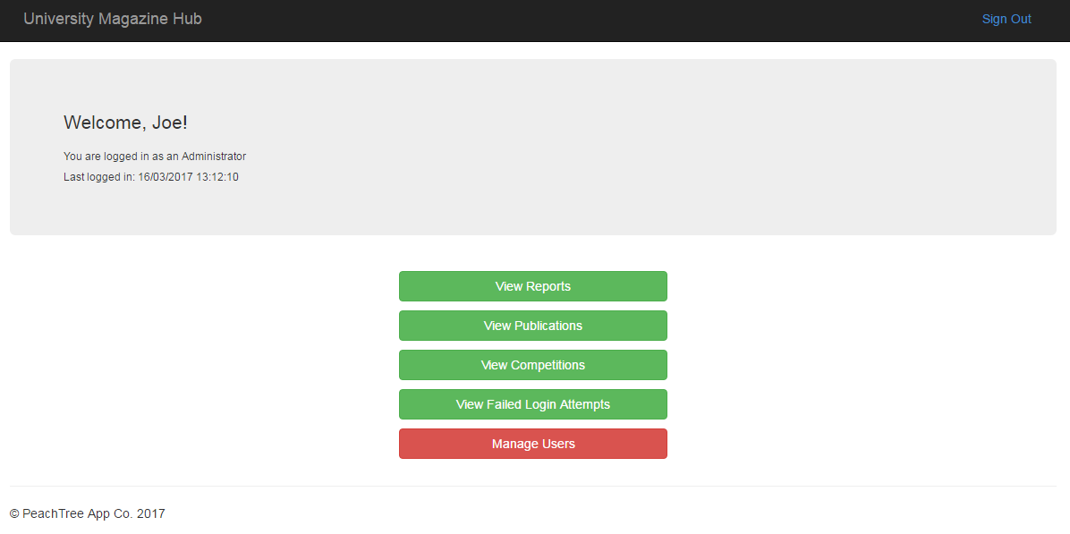
Home

Slide 37
Reports

Slide 38
Publications

Slide 39
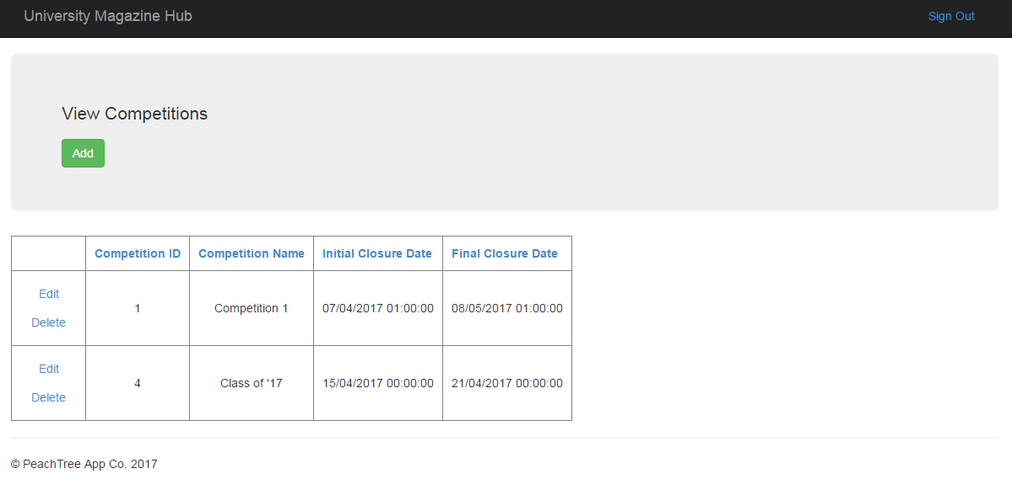
Competitions

Slide 40
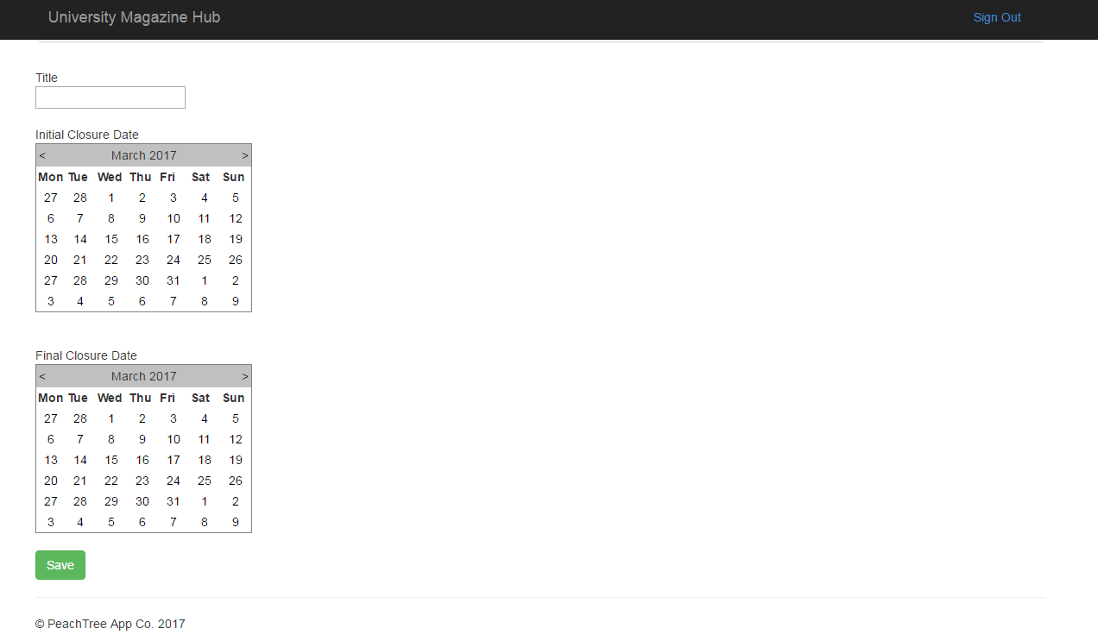
Competitions

Slide 41
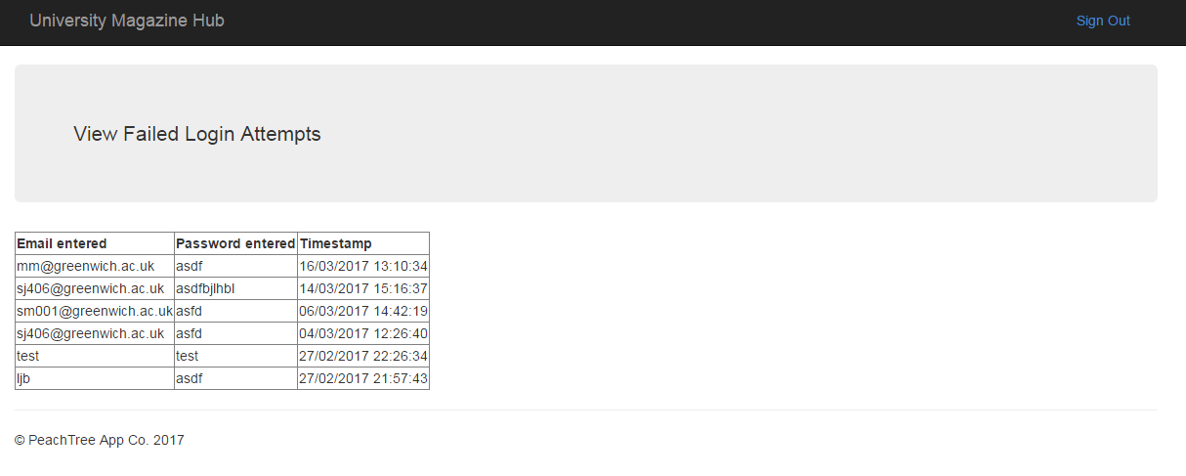
Failed Login Attempts

Slide 42
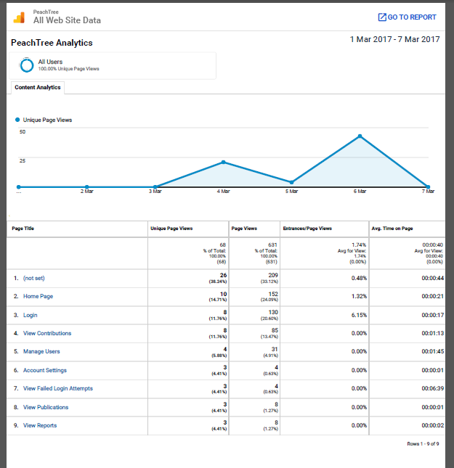
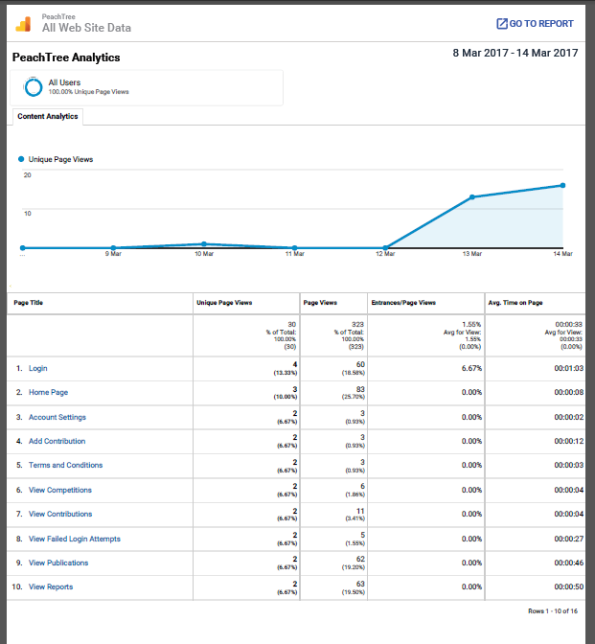
Analytics

Slide 43
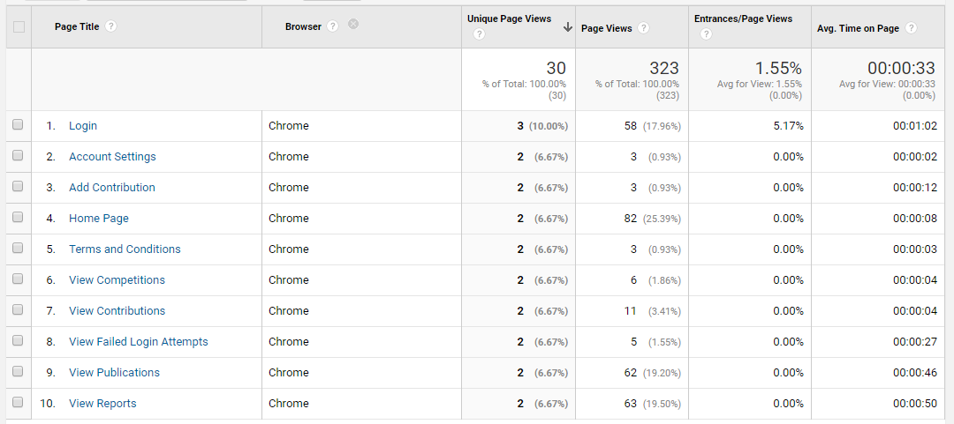
Analytics

Slide 44
Future
Notes:
Mention how in the future we will improve:
UI
Add more functionality to:
Manage users
Fine tune analytics to see more valuable results
Graphical representations of reports
Download images
Download all reports from closed competitions in a zip for marketing manager

Slide 45
Questions

